Slide 1
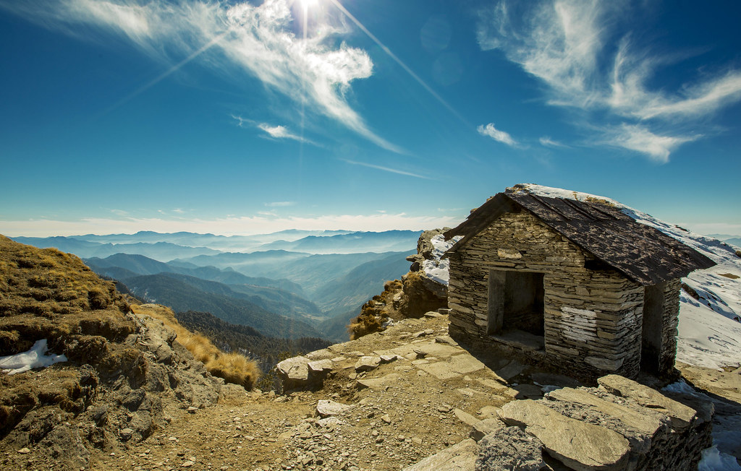

Slide 2
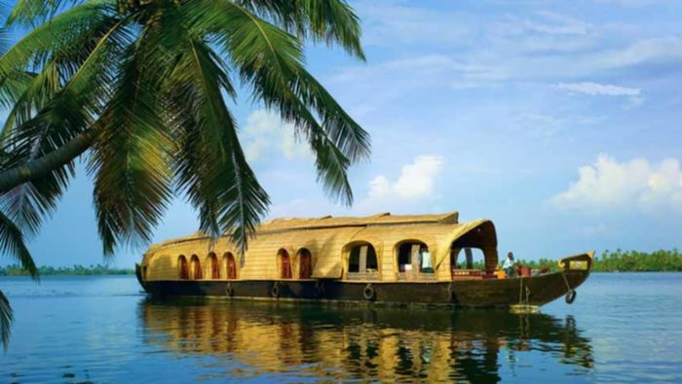
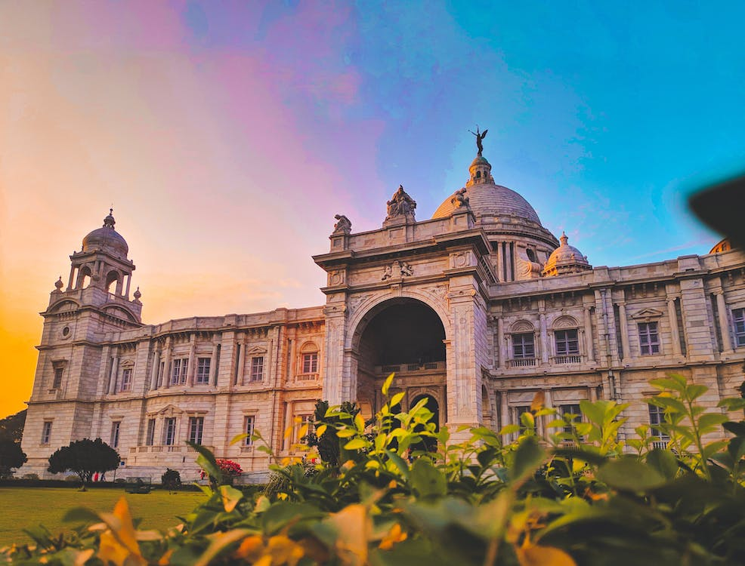
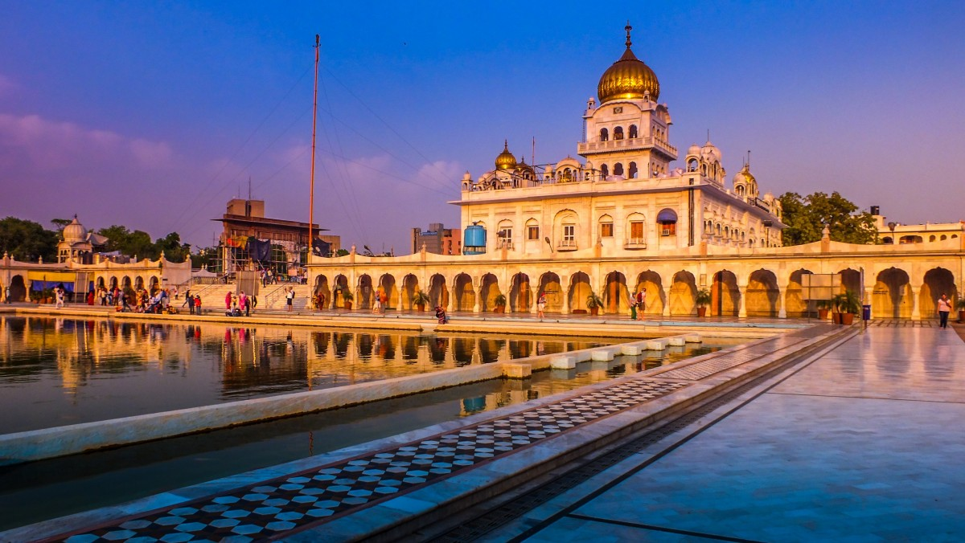
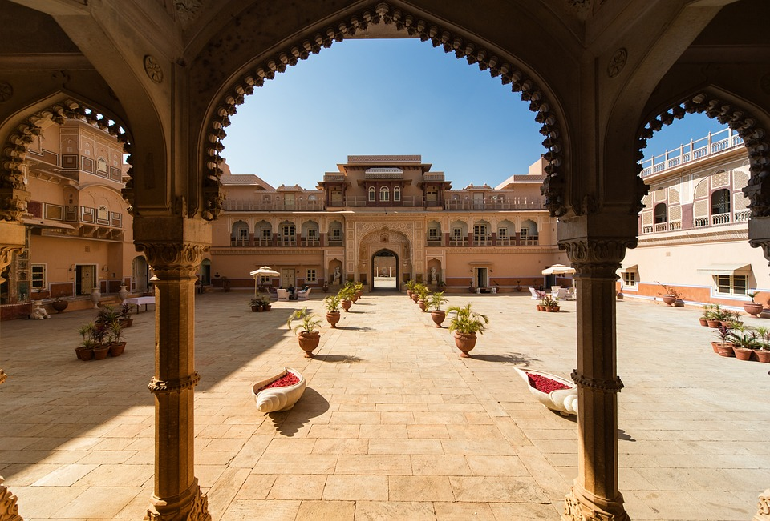
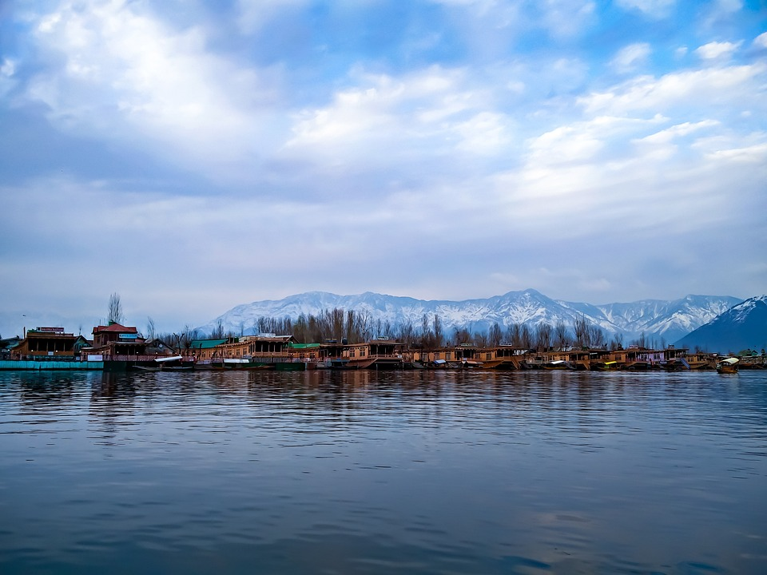
KERELA
KOLKATA
PUNJAB
RAJASTHAN
KASHMIR
KASHMIR
RAJASTHAN
PUNJAB
KOLKATA
KERELA

Slide 3
KERELA
KOLKATA
PUNJAB
KASHMIR
RAJASTHAN
PUNJAB
KOLKATA
KERELA
RAJASTHAN
KASHMIR

Slide 4
KERELA
KOLKATA
KASHMIR
RAJASTHAN
PUNJAB
KOLKATA
KERELA
PUNJAB
RAJASTHAN
KASHMIR

Slide 5
KERELA
KASHMIR
RAJASTHAN
PUNJAB
KOLKATA
KERELA
KOLKATA
PUNJAB
RAJASTHAN
KASHMIR

Slide 6
KASHMIR
RAJASTHAN
PUNJAB
KOLKATA
KERELA
KERELA
KOLKATA
PUNJAB
RAJASTHAN
KASHMIR

